Slide 1

Name: Gopi Prasanna Anumala
Email: 20ne1a1205@gmail.com
College :Tirumala Engineering College
Project: Portfolio Site
Duration: 07-06-2023 To 12-07-2023

Slide 2
PROJECT TITLE
portfolio SITE

Slide 3
AGENDA :
The basic formula of a portfolio website would include a logo, tagline, your best work, and contact information.
A portfolio website is a unique way to showcase your work and let others know about yourself. It’s like an evergreen platform for your projects, case studies, and information about you.
In addition, it’s one of the best ways to express your personality, experience, and capabilities.
The website is clean and easy to navigate.

Slide 4
PROJECT OVERVIEW
A portfolio website usually has several grid elements that consist of a number of images. They are usually organized in a way that the user gets a great experience while using the website.
In this project , we will focus on how the profitolio site is developed by using html ,css and js.
The main aim of this project is to create a profitolio site with audio , video and images.

Slide 5
WHO ARE THE END USERS :
A portfolio website showcases your available work, as well as proof of your skills. This type of website is especially helpful for creative professionals, such as graphic designers, web developers, and photographers.
By having a portfolio website, we can make it easy for potential employers to see our work and assess the skills.
In addition, we can use your website to connect with other professionals in your field and find new opportunities.
The portfolio should include various content that demonstrates the skills and interests.

Slide 6
SOLUTION AND PRESENTATION:
A portfolio site is a goal –driven,organized collections of artifacts and reflections that demonstrate a growth or expansion of knowledge and skills.
The content ,organization and presentation of materials in portfolios can vary greatly depending on the purpose.
Based on the purpose of the client the portfolio site is developed and processed.
The Site includes the all the data according to the needs of the client.
The solution is to design the site and advertize the particular theme.

Slide 7
WOW IN PORTFOLIO SITE:
Provides a Platform to Highlight our Best Work
Great First Impression For Employers
The Specializations and Best Work
Reflects Personality and Creativity
Improves Chances Of Gaining Customers
Consistency and Professionalism

Slide 8
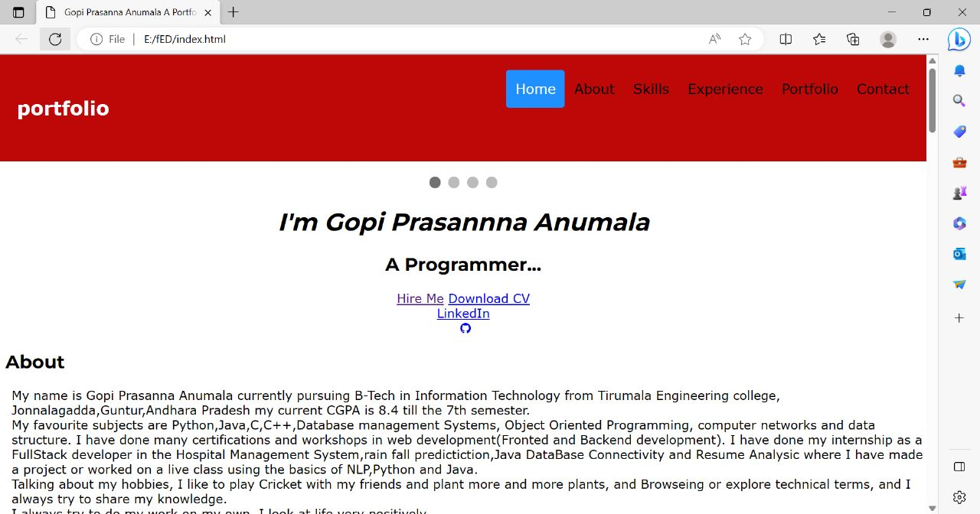
MODELLING:

Slide 9
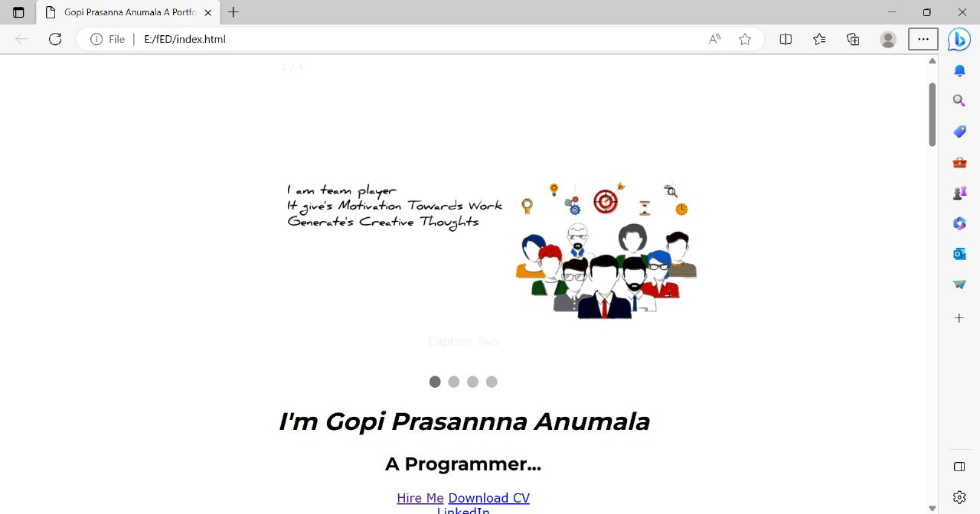
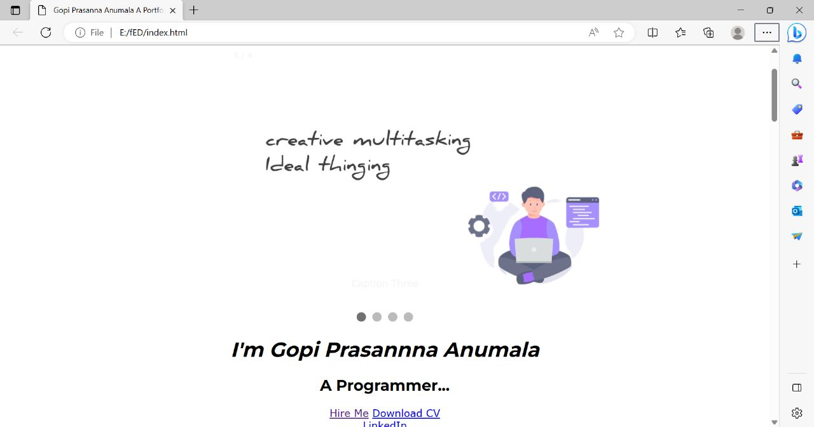

Slide 10
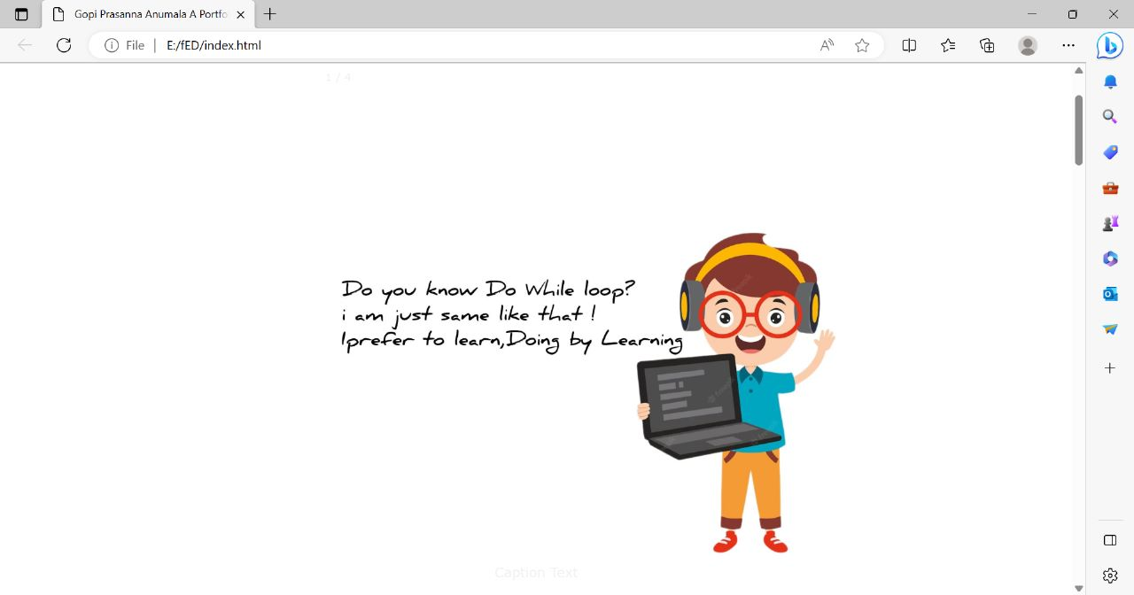
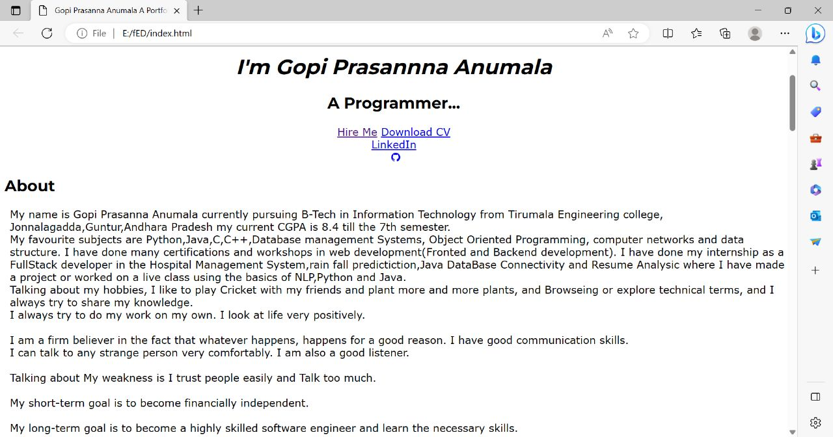

Slide 11
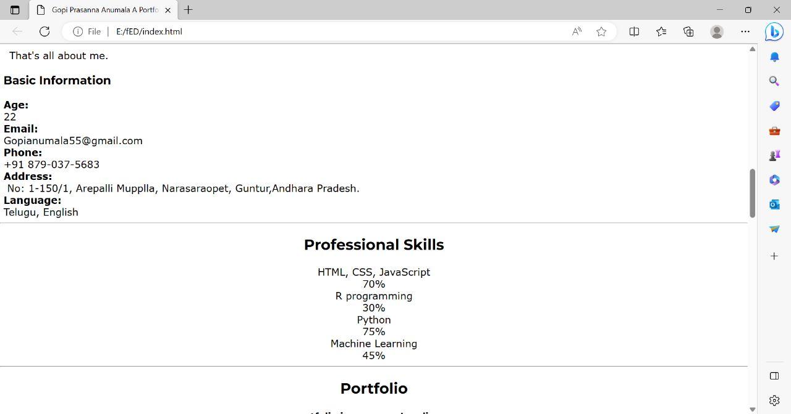
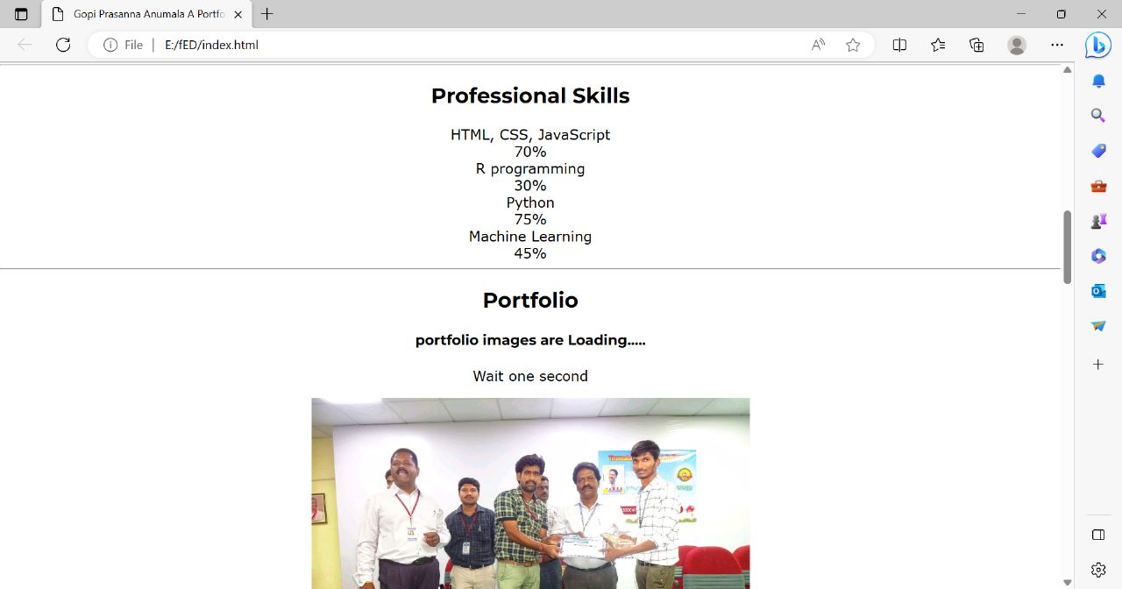

Slide 12
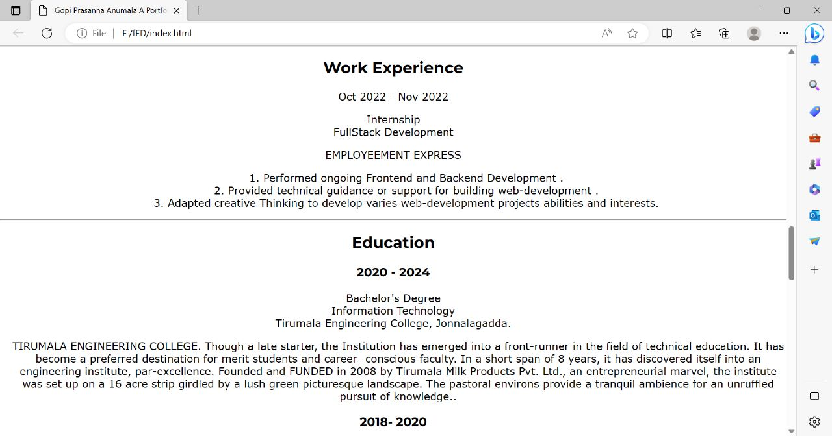
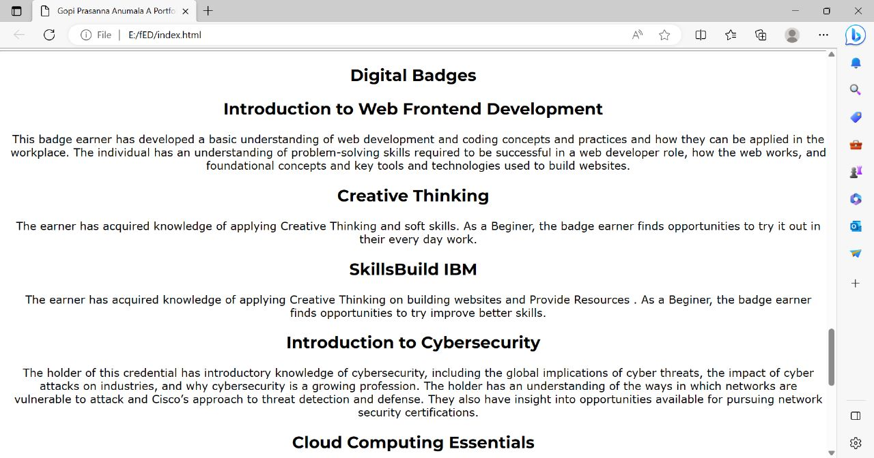

Slide 13
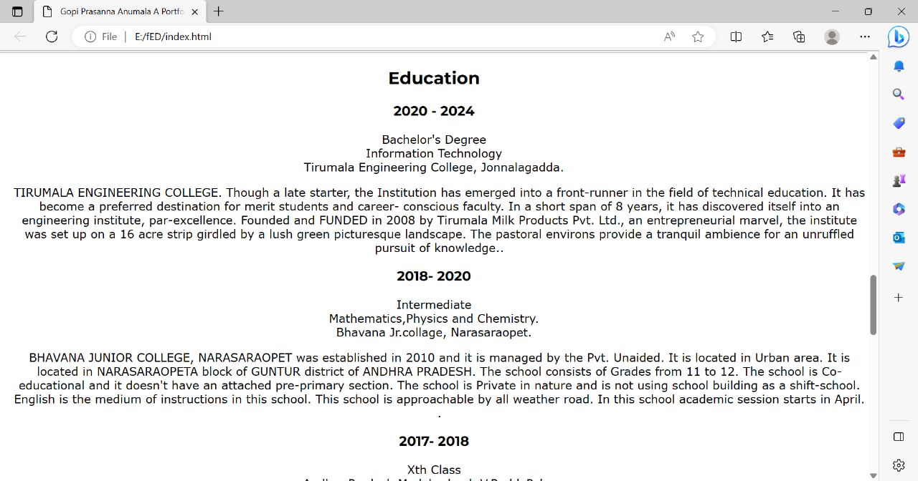
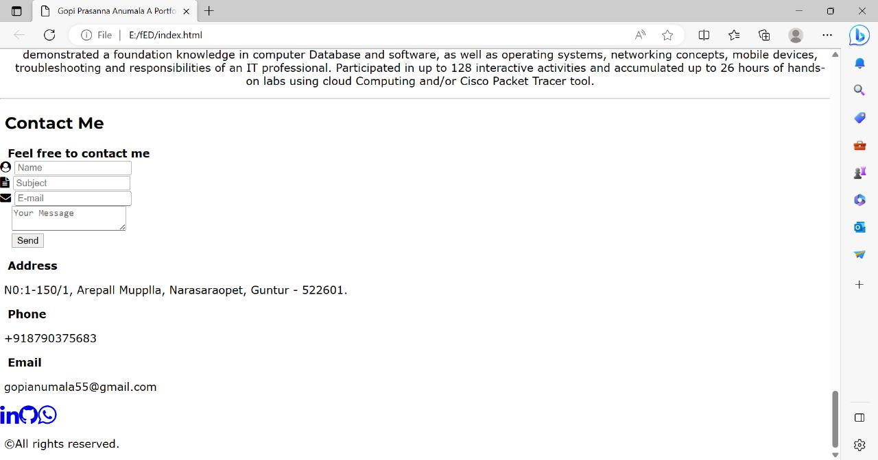

Slide 14
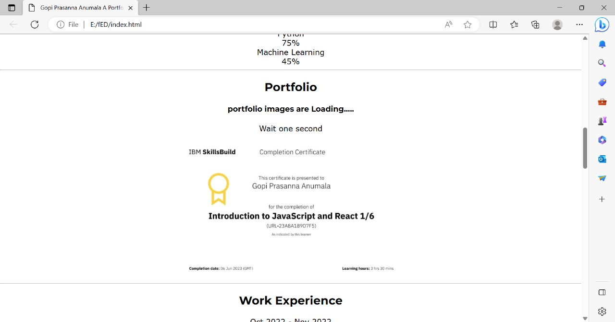
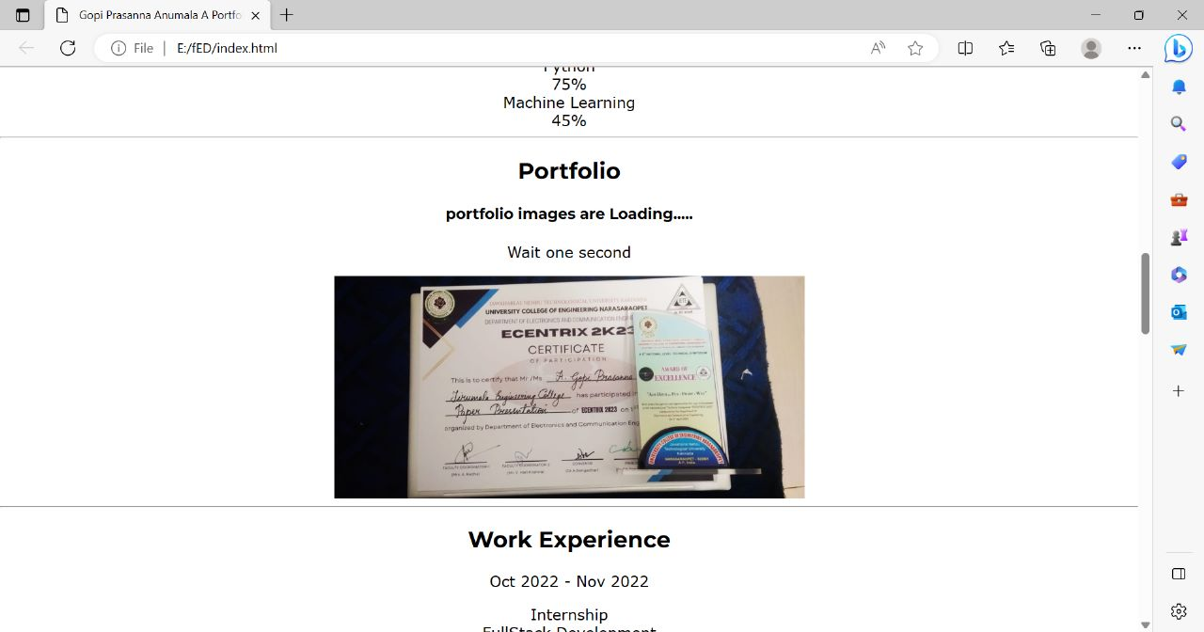

Slide 15
RESULTS:
Link
GitHub : gopianumala/FED (github.com)
LinkedIn: Gopi prasanna Anumala | LinkedIn
Video Link: https://youtu.be/DUHt-jDWPJQ

Slide 16
THANKYOU

